Slide 1

Cyclone Forecasting Using Machine Learning
Cyclones, with their devastating winds and surges, have long been a concern for meteorologists. Over the past century, various studies have been conducted on their structures and forecasting methods. This presentation explores the use of machine learning as a new approach for cyclone prediction and the advancements it offers.
Md Mahamud Hasan

Slide 2

The Challenges of Cyclone Forecasting
Genesis and Intensity
Accuracy of Models
Predicting cyclone genesis and intensity is particularly challenging due to the complex and poorly defined nature of these events. Statistical models often struggle to represent the intricate physical processes involved.
Traditional cyclone models often lack accuracy, especially in predicting cyclone genesis and intensity. Factors such as inaccurate vortex initialization and incomplete representation of physical processes contribute to these limitations.

Slide 3




Machine Learning: A New Approach
Data-Driven
Machine learning algorithms learn from data to identify patterns and relationships, enabling them to make predictions even when the underlying physical mechanisms are unclear.
1
Predictive Accuracy
2
Machine learning models can potentially improve cyclone prediction accuracy by leveraging vast amounts of data and capturing complex, nonlinear relationships.
Applications
3
Machine learning can be applied to various aspects of cyclone forecasting, including genesis, track prediction, intensity forecasting, and associated weather impacts.

Slide 4

Machine Learning in Cyclone Forecasts
1
Genesis Forecasting
Machine learning algorithms like decision trees, support vector machines, and neural networks are being used to predict the likelihood of cyclone formation and the frequency of cyclone genesis in specific regions.
2
Track Forecasting
Machine learning models can predict cyclone trajectories by analyzing cyclone characteristics and associated meteorological and oceanic variables, leading to more accurate path predictions.
3
Intensity Forecasting
Machine learning models can predict cyclone intensity by leveraging data on cyclone characteristics and the surrounding environment, aiding in more accurate forecasts of potential damage.

Slide 5
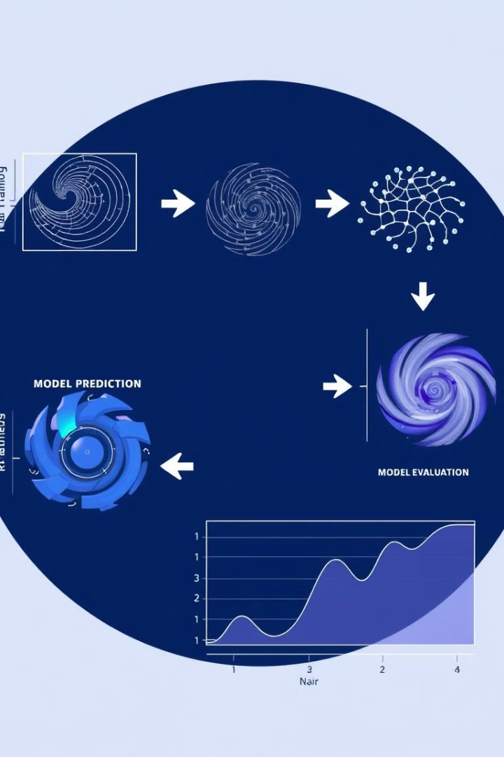



Beyond Data-Driven: Improving Numerical Models
Pre-processing
Machine learning techniques can be used to enhance data quality by identifying and removing errors in the initial fields of numerical models, leading to more accurate inputs.
Model Improvement
Machine learning can contribute to the development of more accurate parameterization schemes within numerical models, enhancing their ability to represent complex physical processes.
Post-processing
Machine learning can be applied to refine the outputs of numerical models, correcting for biases and improving the accuracy of predictions.

Slide 6




Opportunities and Challenges
Data Opportunities
Prediction Challenges
Explainability
The vast amounts of satellite data, reanalysis data, and observations provide a rich source for machine learning to explore and improve cyclone prediction accuracy.
While machine learning has shown promise, achieving stable, long-lead-time predictions, especially for complex phenomena like cyclone genesis, remains a challenge.
The black-box nature of machine learning, especially deep learning, raises concerns about its ability to provide insights into the physical mechanisms driving cyclone behaviour.

Slide 7
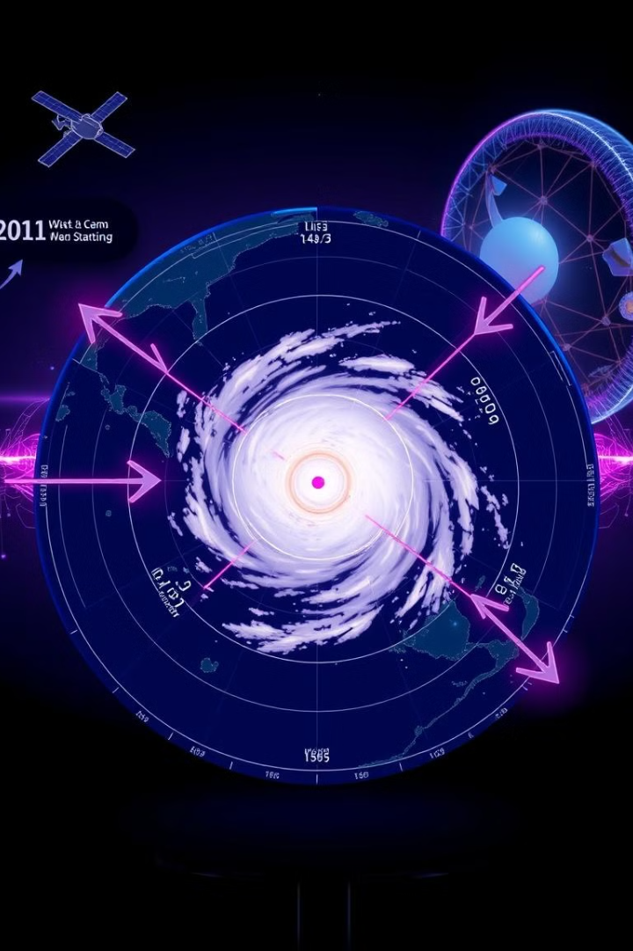
The Future of Cyclone Forecasting
Multi-Source Data
Integrating data from various sources, such as satellites, reanalysis, and in-situ observations, can significantly enhance the performance of machine learning models for cyclone prediction.
Hybrid Models
Combining the strengths of data-driven and physics-based models holds immense potential for achieving more accurate and reliable cyclone forecasts.
Improved Explainability
Developing machine learning models that provide insights into the underlying physical processes driving cyclone behaviour is crucial for building trust and acceptance in these models.

Slide 8

Conclusion
Machine learning offers a promising avenue for advancing cyclone forecasting by leveraging data and uncovering patterns. Although challenges remain, the potential of machine learning in this field is undeniable. Further research and development are essential to unlock its full capabilities, creating a future where more accurate and reliable cyclone forecasts protect lives and mitigate the impact of these devastating storms.

